Slide 1
Module - 4 : Introduction to Database

Slide 2
1. Overview of Databases and their Importance
In web development, databases are the backbone of persistent data storage and retrieval. They allow you to store, manage, and access information critical for your application's functionality. Here's why databases are essential:
Centralised Data Storage: Consolidated information in a single location ensures consistency and eliminates the need for scattered data files.
Efficient Data Management: Databases provide efficient tools for adding, searching, updating, and deleting data.
Scalability: Databases can grow as your application's data volume increases, accommodating larger datasets.
Data Security: Databases offer features like access control and user permissions to protect sensitive data.
Data Integrity: Database structures enforce data integrity, ensuring data consistency and preventing errors.

Slide 3
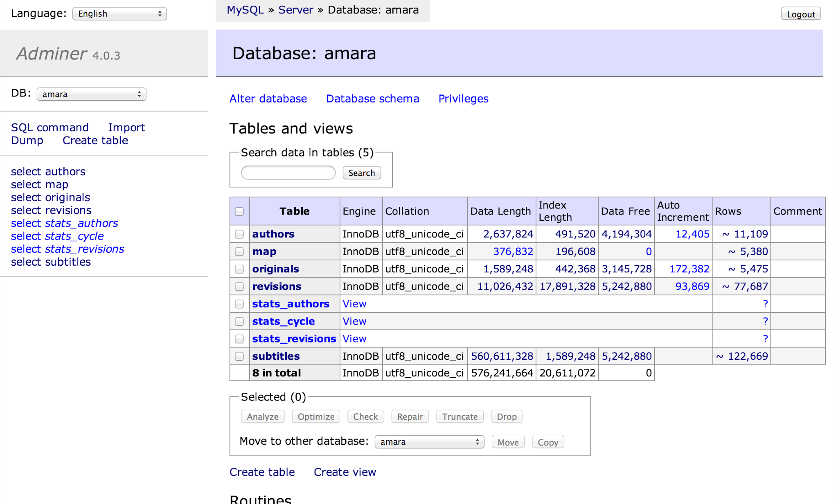

Slide 4
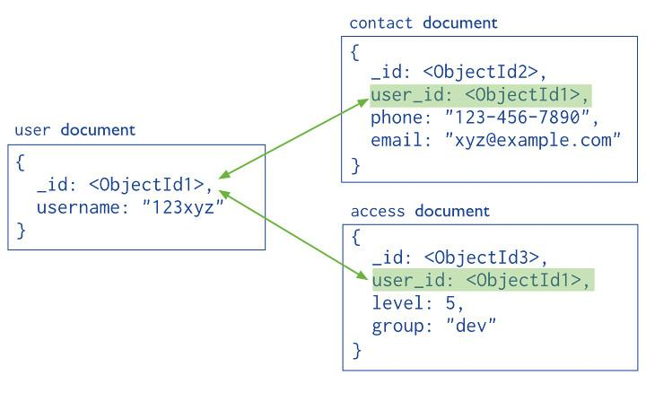

Slide 5
SQL vs. NoSQL Databases
The two main database categories are SQL (Structured Query Language) and NoSQL (Not Only SQL). Each has its strengths and weaknesses, and the best choice depends on your specific needs.
2.1. SQL Databases
Structure: SQL databases follow a relational model, where data is organized into tables with rows and columns. Each table has a defined schema (structure) enforcing data types and relationships with other tables.
Query Language: SQL is used to interact with relational databases. You can write queries to select, insert, update, and delete data based on specific conditions.
Examples: MySQL, PostgreSQL, Oracle Database (common choices for web applications)
2.2. NoSQL Databases
Structure: NoSQL databases offer more flexibility in data structure. They can handle data in various formats like documents (JSON), key-value pairs, or graphs.
Query Language: NoSQL databases have their own query languages or APIs for data manipulation.
Scalability: NoSQL databases often excel at horizontal scaling, meaning you can easily add more servers to handle increased data load.
Examples: MongoDB, Cassandra, Redis (often used for large datasets, real-time applications, and caching)

Slide 6
Choosing the Right Database:
Consider these factors when selecting a database for your web application:
Data Structure: Does your data fit well within a relational model, or is a more flexible approach needed.
Scalability: How much data growth do you anticipate
Performance Requirements: Does your application prioritize speed and low latency
Query Complexity: What types of complex queries will your application need to perform
Common Use Cases for SQL and NoSQL Databases
Choosing between SQL and NoSQL databases depends on your application's specific needs. Here's a breakdown of their common use cases:
SQL Databases:
E-commerce applications: Storing product information, customer details, orders, and transactions (relational structure fits well for complex queries involving product categories, user accounts, and order histories).
Content management systems (CMS): Managing website content (articles, pages, users) with well-defined relationships between content pieces and user roles.
Financial applications: Storing account information, transactions, and financial data requiring strong data integrity and complex queries (relational structure ensures data consistency).
Enterprise applications: Handling large amounts of structured data with complex relationships, often requiring data normalization for efficient retrieval (relational model scales well for big data).

Slide 7
NoSQL Databases:
Real-time applications: Storing and updating data that needs immediate reflection on the user interface (e.g., chat applications, social media feeds).
Big data analytics: Handling massive datasets that might not fit well in a relational structure (NoSQL databases often scale horizontally for large data volumes).
Content management systems (for unstructured data): Storing user-generated content like images, videos, and social media posts that don't require strict relational modeling.
Mobile applications: Managing user data and application state on the client-side, requiring flexibility and potential for offline functionality (NoSQL databases can be a good fit for mobile app data storage).

Slide 8
Introduction to SQL (Structured Query Language) with MySQL Syntax
Examples
SQL is a standardised language for interacting with relational databases. Here are some basic SQL statements using MySQL syntax:
1. CREATE TABLE: Defines the structure of a new table.
CREATE TABLE users (
id INT PRIMARY KEY AUTO_INCREMENT,
username VARCHAR(255) NOT NULL UNIQUE,
email VARCHAR(255) NOT NULL UNIQUE,
password VARCHAR(255) NOT NULL
);

Slide 9
2. INSERT INTO: Adds a new row of data to a table.
INSERT INTO users (username, email, password) VALUES ('alice', 'alice@example.com', 'secret_password');
3. SELECT: Retrieves data from one or more tables.
SELECT * FROM users; # Select all columns from the 'users' table
SELECT id, username FROM users WHERE email = 'alice@example.com'; # Select specific columns with a condition
4. UPDATE: Modifies existing data in a table.
UPDATE users SET password = 'new_password' WHERE id = 1;
5. DELETE: Removes rows from a table.
DELETE FROM users WHERE username = 'bob';

Slide 10
Database Schema Design Principles
A well-designed database schema is the backbone of efficient data storage and retrieval in your web applications. Here are key principles to follow:
Normalisation:
  Aim to minimize data redundancy to avoid inconsistencies and errors. Imagine having a customer's address stored in multiple places – any update to that address would require changes in every location, increasing the risk of mistakes.
  Normalisation involves breaking down tables into smaller, focused tables with defined relationships. There are different normalisation levels (1NF, 2NF, 3NF, BCNF) that progressively reduce redundancy.
Data Types:
  Define appropriate data types (e.g., INTEGER, VARCHAR, DATE) for each column to ensure data integrity and efficient storage.
  For example, an INTEGER column is ideal for storing numeric values like product IDs, while a VARCHAR (variable character) is suitable for storing text data like customer names.

Slide 11
Primary and Foreign Keys:
  Each table should have a primary key (unique identifier for each row). This is like a unique serial number for each record.
  Use foreign keys to establish relationships between tables. A foreign key in one table references the primary key of another table.
  Imagine an orders table and a customers table. The orders table might have a customer_id foreign key referencing the primary key (e.g., id) of the customers table, allowing you to link orders to specific customers.
Constraints:
  Utilize constraints like NOT NULL, UNIQUE, and CHECK to enforce data integrity and prevent invalid data from entering the database.
    NOT NULL ensures columns cannot be empty.
    UNIQUE guarantees no duplicate values exist in a column (useful for things like email addresses).

Slide 12
    CHECK allows defining custom conditions that data must satisfy (e.g., ensuring a product price is always positive).
Relationships:
  Carefully model relationships between data entities (tables) to represent the real-world scenario your application reflects. Here are some common relationships:
    One-to-One: A single record in one table corresponds to exactly one record in another table (e.g., a user table and a profile table).
    One-to-Many: A single record in one table can be linked to many records in another table (e.g., a customer table and an orders table).
    Many-to-Many: Many records in one table can be linked to many records in another table (e.g., an actors table and a movies table, with many actors starring in multiple movies).
Code Example (Normalisation in SQL):
Imagine a scenario where you have an orders table storing order details and a customer_details table with customer information. Initially, you might consider a design like this:

Slide 13
CREATE TABLE orders (
id INT PRIMARY KEY AUTO_INCREMENT,
customer_name VARCHAR(255),
customer_email VARCHAR(255),
product_name VARCHAR(255),
quantity INTEGER
);
This design has redundancy (customer information stored in both tables). A normalized approach would involve separate tables:
CREATE TABLE customers (
id INT PRIMARY KEY AUTO_INCREMENT,
name VARCHAR(255),
email VARCHAR(255) UNIQUE
);

Slide 14
CREATE TABLE orders (
id INT PRIMARY KEY AUTO_INCREMENT,
customer_id INT,
product_name VARCHAR(255),
quantity INTEGER,
FOREIGN KEY (customer_id) REFERENCES customers(id)
);
This separates customer data and order data, reducing redundancy. The orders table now has a customer_id foreign key referencing the id primary key in the customers table, allowing you to link orders to specific customers.
Understanding Database Joins and their Types
Joins are used to combine data from multiple tables based on a shared relationship (often established through foreign keys). Here are some common join types:

Slide 15
1. INNER JOIN:
* Returns rows where there's a match in both tables based on the join condition.
SELECT orders.id, customers.name, orders.product_name, orders.quantity
FROM orders
INNER JOIN customers ON orders.customer_id = customers.id;
2. LEFT JOIN:
Returns all rows from the left table (the one mentioned first), and matching rows from the right table. If there's no match in the right table, null values are returned for that table's columns. This is useful for scenarios where you want to see all orders, even if a customer might not have placed any yet.
SELECT orders.id, customers.name, orders.product_name, orders.quantity
FROM orders
LEFT JOIN customers ON orders.customer_id = customers.id;

Slide 16
3. RIGHT JOIN:
Similar to LEFT JOIN, but returns all rows from the right table and matching rows from the left table. Null values are returned for left table columns if there's no match. This might be useful if you have a list of all customers and want to see their orders, even if they haven't placed any yet.
SELECT orders.id, customers.name, orders.product_name, orders.quantity
FROM customers
RIGHT JOIN orders ON orders.customer_id = customers.id;
4. FULL JOIN:
Returns all rows from both tables, including those with no matching data in the other table (filled with null values). This can be helpful when you want to

Slide 17
see a complete picture of data from both tables, regardless of whether there's a direct relationship.
SELECT orders.id, customers.name, orders.product_name, orders.quantity
FROM customers
FULL JOIN orders ON orders.customer_id = customers.id;
5. UNION:
The UNION operator combines the results of two or more SELECT statements. It removes duplicate rows by default.
SELECT name FROM customers
UNION
SELECT product_name FROM orders;
This query would combine the list of customer names and product names, but it would only include unique entries (no duplicates).

Slide 18
6. UNION ALL:
UNION ALL is similar to UNION but keeps all rows, including duplicates.
SELECT name FROM customers
UNION ALL
SELECT product_name FROM orders;
Database Indexing and Performance improvement
What is Indexing?
Imagine a library – books are arranged on shelves, but finding a specific book can be time-consuming if you have to scan every shelf. Indexing is like creating a catalogue for your database tables. It's a structured way to organise data to enable faster retrieval based on specific columns.
Importance of Indexing:
Faster Queries: Indexes act like shortcuts, allowing the database to quickly locate relevant data without scanning the entire table. This significantly improves query performance, especially for complex queries or large datasets.
Optimized Joins: When joining tables, indexes on the join columns can significantly speed up the process.
Improved Efficiency: Efficient queries translate to better overall application performance and user experience.

Slide 19
Types of Indexes:
Primary Key Index: Every table should have a primary key, and it automatically has a unique index associated with it to ensure efficient lookups.
Secondary Indexes: These are created on specific columns that are frequently used in WHERE clauses or joins.
Creating Indexes in SQL
Syntax Example (MySQL):
CREATE TABLE products (
id INT PRIMARY KEY AUTO_INCREMENT,
name VARCHAR(255),
category VARCHAR(255),
price DECIMAL(10,2),
INDEX idx_category (category) -- Create an index on the 'category' column
);

Slide 20
Choosing the Right Columns for Indexing:
Consider columns frequently used in WHERE clauses, filtering conditions, joins, and ORDER BY clauses.
Indexing columns with high cardinality (many distinct values) can be less beneficial than indexing those with low cardinality (fewer distinct values).
Database Management Tools
While you can interact with databases directly using SQL, there are graphical tools that simplify database administration tasks:
- MySQL Workbench (Download Link: https://dev.mysql.com/downloads/workbench/)
A popular, free, cross-platform tool for MySQL administration.
Provides a user-friendly interface for creating, managing, and querying databases.
Offers features like visual database design, SQL editing and execution, data import/export, user management, and more.
pgAdmin (Download Link: https://www.pgadmin.org/download/)
A free, open-source administration and development platform for PostgreSQL databases.
Supports managing multiple PostgreSQL servers from a single interface.
Offers features like visual query building, server management, user creation, data browsing, and backup/restore functionalities.

Slide 21
- phpMyAdmin (Available on most web hosting platforms)
A web-based administration tool for MySQL and MariaDB databases.
Accessible through your web hosting control panel, allowing you to manage databases directly from a web browser.
Provides features like table management, data manipulation (insert, update, delete), user management, and import/export options.
Introduction to NoSQL Databases
What are NoSQL Databases?
NoSQL (Not Only SQL) databases offer an alternative to traditional relational databases (e.g., MySQL, PostgreSQL). Unlike relational databases that follow a strict schema with rows and columns, NoSQL databases provide more flexible data structures. This flexibility makes them well-suited for handling large datasets, unstructured data, and applications with evolving data models.

Slide 22
Common NoSQL Database Types:
Document Databases: Store data in JSON-like documents, allowing for flexible schema and complex data structures (e.g., MongoDB).
Key-Value Stores: Store data as key-value pairs, offering fast retrieval based on keys (e.g., Redis).
Wide-Column Stores: Organize data in tables with columns that can vary in structure across rows (e.g., Cassandra).
Graph Databases: Represent data as nodes (entities) and relationships between them, ideal for modeling connections (e.g., Neo4j).
2. Advantages of NoSQL Databases
Scalability: NoSQL databases often excel at horizontal scaling, meaning you can easily add more servers to handle increased data load. This is beneficial for rapidly growing datasets.
Flexibility: The schema-less or flexible schema nature of NoSQL allows for storing data in various formats without rigid table structures. This can be advantageous for evolving data models or applications that handle diverse data types.
Performance: NoSQL databases can offer faster performance for certain operations, especially when dealing with large datasets or unstructured data.

Slide 23
3. When to Use NoSQL Databases
Consider using NoSQL databases for:
Big Data Applications: When you anticipate massive datasets that might not fit well in a relational model.
Real-time Applications: Applications that require high availability and fast data updates (e.g., chat applications, social media feeds).
Unstructured Data Storage: Storing data that doesn't fit neatly into a relational model (e.g., user profiles with varying data points).
Evolving Data Models: Scenarios where your data structure might change frequently, and a schema-less approach is preferred.
Introduction to MongoDB
MongoDB is a popular document-oriented NoSQL database known for its scalability, flexibility, and performance. Documents in MongoDB store data in a JSON-like format, allowing for rich data structures.

Slide 24
Key Features of MongoDB:
Document-Oriented: Stores data in flexible JSON-like documents.
Schema-less: Doesn't enforce a strict schema, allowing for diverse data structures within a collection (similar to a table).
Horizontal Scaling: Scales horizontally by adding more servers (sharding) to handle increasing data volumes.
Rich Queries: Supports querying documents using a JSON-like query language.
Node.js and MongoDB Integration (Basic Example):
While you can interact with MongoDB directly using its shell or other tools, Node.js provides a popular way to interact with MongoDB from your web applications. Here's a basic example using the mongoose library:
Prerequisites:
Node.js and npm (Node Package Manager) installed on your system.
Steps:
Install Mongoose:
npm install mongoose

Slide 25
Connect to MongoDB:
const mongoose = require('mongoose');
const uri = "mongodb://localhost:27017/yourDatabaseName"; // Replace with your connection string
mongoose.connect(uri, { useNewUrlParser: true, useUnifiedTopology: true })
.then(() => console.log('MongoDB connected'))
.catch(err => console.error('Connection error:', err));
Define a Mongoose Schema:
const userSchema = new mongoose.Schema({

Slide 26
name: String,
email: String
});
const User = mongoose.model('User', userSchema);
Create a User (Example):
const newUser = new User({ name: 'Alice', email: 'alice@example.com' });
newUser.save()
.then(() => console.log('User created!'))
.catch(err => console.error('Error creating user:', err));

Slide 27
1. MongoDB Features and Architecture
Key Features:
Document-Oriented: Stores data in flexible, JSON-like documents that can hold various data types and structures within a single document.
Schema-less: Doesn't enforce a rigid schema, allowing for diverse data structures within a collection.
Horizontal Scaling: Scales by adding more servers (sharding) to handle increasing data volumes.
Rich Queries: Supports querying documents using a JSON-like query language.
Ad-hoc Queries: Allows querying documents without predefined structures, making it suitable for evolving data models.
Indexes: Similar to relational databases, MongoDB uses indexes to optimize query performance.
Architecture:
Sharding: Distributes data across multiple servers (shards) for scalability and redundancy.
Replication: Creates copies of data on different servers for high availability and disaster recovery.
Replica Sets: A group of MongoDB servers that maintain consistent data copies, ensuring continuous operation if a primary server fails.

Slide 28
. Basic Schema Design in MongoDB
Collections and Documents:
Collections: Similar to tables in relational databases, but with a more flexible structure. A collection holds documents of a similar type (e.g., a users collection stores user documents).
Documents: JSON-like records that represent individual data entries within a collection. Each document has a unique identifier (_id) and can contain various fields with different data types (strings, numbers, arrays, nested objects).
Example: User Collection:
{
"_id": ObjectId("6301f7f2d4212...", // Unique identifier generated by MongoDB
"name": "Alice",
"email": "alice@example.com",
"age": 30,
"address": {
"street": "123 Main St",

Slide 29
"city": "Anytown",
"state": "CA"
}
}
{
"_id": ObjectId("6301f7f2d4213...",
"name": "Bob",
"email": "bob@example.com",
"interests": ["programming", "music"],
"isAdmin": true
}
Relationships in MongoDB:
Unlike relational databases with predefined joins, MongoDB allows for embedding documents within other documents to model relationships.
For example, an orders collection could have an items array containing nested documents for each item in an order.

Slide 30
3. Advantages of Flexible Schema Design:
Accommodates Diverse Data: Can store data with varying structures within a collection, making it suitable for evolving data models.
Simplifies Complex Data: Nested documents allow you to represent complex data hierarchies in a single document.
Reduced Schema Overhead: Avoids the need for complex table joins often required in relational databases.
4. Node.js and Mongoose Schema Example (Recap):
We previously explored a basic example of connecting to MongoDB and creating a schema using Mongoose. Here's that example again for reference:
const mongoose = require('mongoose');
const userSchema = new mongoose.Schema({
name: String,
email: String
});

Slide 31
const User = mongoose.model('User', userSchema);
const newUser = new User({ name: 'Charlie', email: 'charlie@example.com' });
newUser.save()
.then(() => console.log('User created!'))
.catch(err => console.error('Error creating user:', err));
. MongoDB Aggregation Pipeline
The Aggregation Pipeline is a powerful framework in MongoDB that allows you to process, transform, and group data to generate summarised results. It works by applying a series of stages that operate on documents and produce output for the next stage.
Common Stages:
$match: Filters documents based on a specified condition.
$project: Selects specific fields to include or exclude from the output documents.
$group: Groups documents based on a field or expression and performs calculations like $sum, $avg, or $count.
$sort: Sorts documents based on a specified field in ascending or descending order.
$lookup: Enables joining data from multiple collections.

Slide 32
Example (Node.js with Mongoose):
const mongoose = require('mongoose');
const orderSchema = new mongoose.Schema({
customerId: String,
items: [{
productId: String,
quantity: Number
}]
});
const Order = mongoose.model('Order', orderSchema);

Slide 33
// Aggregation pipeline to find total quantity per product
Order.aggregate([
{ $unwind: "$items" }, // Deconstruct the items array into separate documents
{ $group: { _id: "$items.productId", totalQuantity: { $sum: "$items.quantity" } } },
{ $sort: { totalQuantity: -1 } } // Sort by total quantity (descending)
])
.then(data => console.log(data))
.catch(err => console.error(err)
This example retrieves the total quantity sold for each product across all orders.
Integration of MongoDB with popular programming languages
1. Integrating MongoDB with Node.js
We've already seen basic Node.js and Mongoose interaction. Here are some additional points:
Mongoose provides a convenient object-oriented layer for interacting with MongoDB.
You can use the find, findOne, update, and delete methods on Mongoose models to perform CRUD operations on documents.
Mongoose automatically handles data conversion between JavaScript objects and MongoDB documents.

Slide 34
2. Integrating MongoDB with Python
Popular Python libraries for interacting with MongoDB include:
PyMongo: The official Python driver for MongoDB, offering a low-level interface for full control.
Motor: An asynchronous driver for MongoDB, well-suited for building high-performance web applications.
Example (Python with PyMongo):
from pymongo import MongoClient
client = MongoClient("mongodb://localhost:27017/")
db = client["yourDatabaseName"]
collection = db["products"]

Slide 35
# Find all products with price greater than $10
products = collection.find({"price": {"$gt": 10}})
for product in products:
print(product)

